Slide 1
GIT &Github
By:Ahmed Elmorshdy

Slide 2
Agenda
Git
What's the Git
Advantages
How to install Git
Command Line
Terminolgy
Github
Create account
Create repo
Push
pull
Dealing with team
Branch
merge
Stash
Restore&clean
Reset
Resources

Slide 3
What's GIT :
Distributed Version Control System
is software for tracking changes in any set of files, usually used for coordinating work among programmers collaboratively developing source code during software development. Its goals include speed, data integrity, and support for distributed, non-linear workflows (thousands of parallel branches running on different systems)

Slide 4

Advantages:

Slide 5
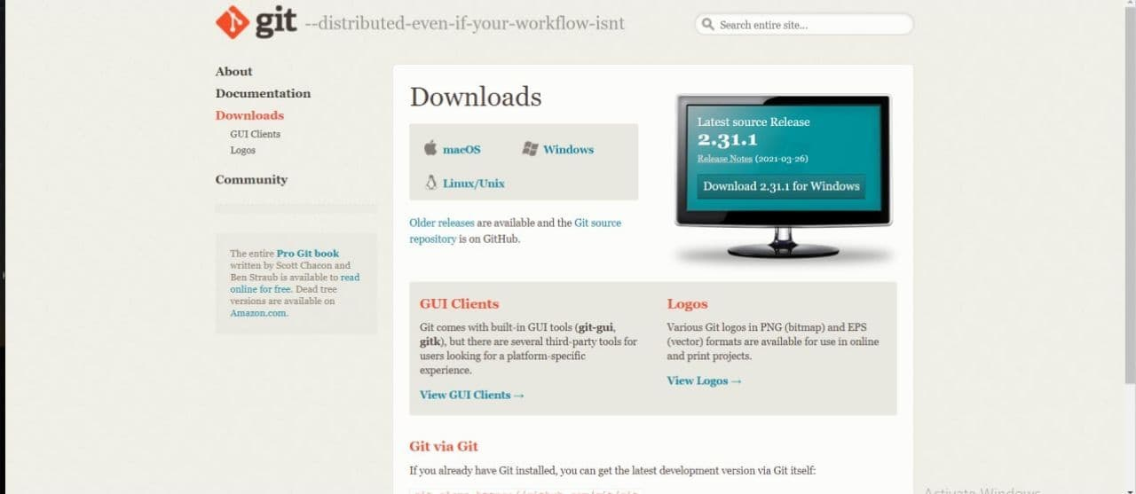
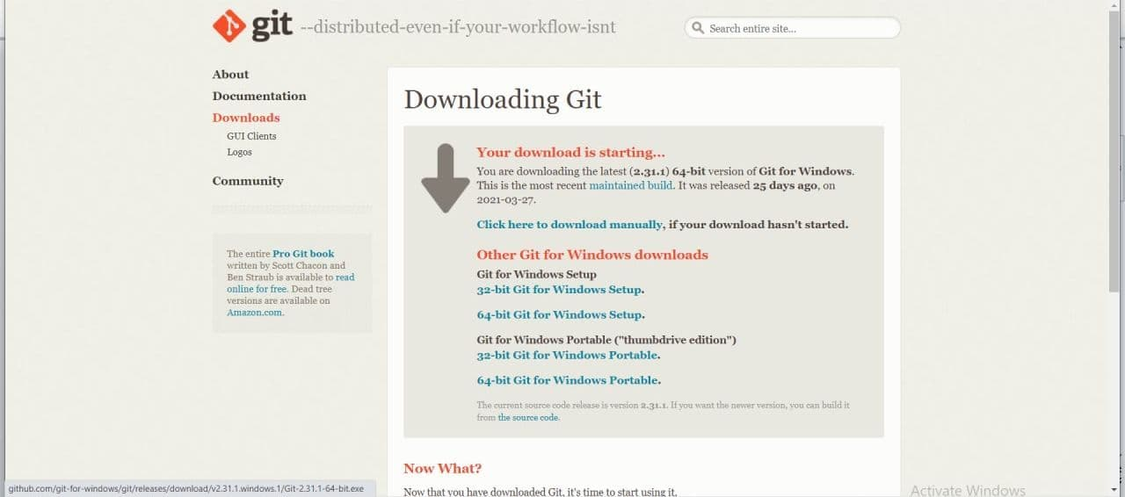
Installing and setup Git

Slide 6



Slide 7
Command Line
Cd : used to change the current working directory
Mkdir : allows the user to create directories
Touch : create a file
Ls : lists files and directories within the file system

Slide 8
Terminolgy
Repositary :
Push : used to upload local repository content to a remote repository.
Pull : used to download and integrate remote changes
Branch
origin

Slide 10

How to create account?

Slide 11
Create Repo and download to pc
Steps
Create Repo in github
Copy link from repo
Use command line
Go to location and create folder
git clone + (linke)

Slide 12
Make changes and push it to origin
Steps
add files
git add *
git commit –m “”
push

Slide 13
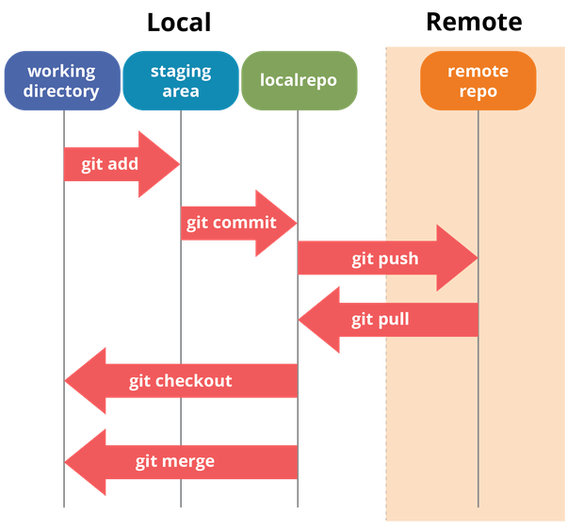

Slide 14
Push an existing project

Slide 15
Pull and teamwork
Steps
Pull Request
Add Collaborator to project

Slide 16
Branch
Add B ranch
git branch + name
Switch to new branch
git checkout + name
Remove branch
git branch –D + name
Rename new branch
git branch –m + name

Slide 17
Merge
Steps
Make changes
Switch to main branch
Merge branch name
Commit
push

Slide 18
Another Way

Slide 19

Stash

Slide 20
Stash
shelves (or stashes) changes you've made to your working copy so you can work on something else, and then come back and re-apply them later on
git stash
git stash list
git stash pop
git stash pop stash@(N)

Slide 21
Remove from stash
git stash drop
git stash drop stash@{n}

Slide 22
Restore & clean
Restore
git restore –staged + name
git restore –staged *
Clean
git clean –n
Git clean -f

Slide 23
Rest
Steps
Point to head
git reset –hard +hash
push

Slide 24

Task

Slide 25
Resources
Dawnload Git :https://git-scm.com/downloads
Command Line :https://www.youtube.com/watch?v=JVs2Ywy7wGQ&list=PLDoPjvoNmBAxzNO8ixW83Sf8FnLy_MkUT
Github :https://www.youtube.com/watch?v=ACOiGZoqC8w&list=PLDoPjvoNmBAw4eOj58MZPakHjaO3frVMF
Book : https://drive.google.com/drive/u/0/folders/17fWwbV1pzW_7HATDWK7G2-E909uNdIi9

Slide 26
THANK YOU

